Slide 1
Functions and Objects
Session 10
(slot 17-18-19)

Slide 2
Objectives
User-defined functions.
User-defined objects.
JavaScript objects.

Slide 3
What is a function?
A function is an independent reusable block of code that performs certain operations on variables and expressions to fulfill a specific task.
In JavaScript, a function is similar to method, but there is a little difference between them. A method is always associated with an object and is executed by referencing that object. But a function is executed independently.
In JavaScript, a function is always created under the Script element.

Slide 4
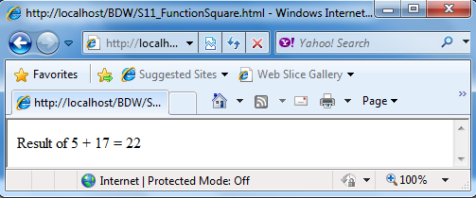
Function Definition
Syntax:
function <functionName>([paraList])
{
//Body of function
}
<functionName>: comply with identifier naming convention.
[paraList]:is optional. If there are many parameters, separated by commas.
<html xmlns="http://www.w3.org/1999/xhtml">
<head>
<script language="javascript" type="text/javascript">
function add(num1, num2)
{
var result = num1 + num2;
document.write("Result of " + num1 + " + " + num2 + " = " + result);
}
</script>
</head>
<body onLoad="add(5, 17)">
</body>
</html>

Slide 5
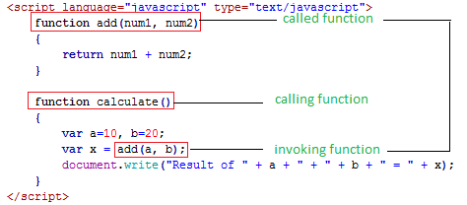
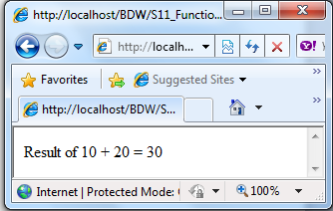
Invoking functions
You can invoke or call a function to execute it in the browser.
You can call a function from another function in JavaScript. The function that calls another function is called calling function, whereas, the called function is referred to as the called function.
Syntax to calling a function
<functionName>([paralist]);

Slide 6
Ways of passing parameters
There are two ways of passing parameters to a function namely, pass by value and pass by reference.
Passing by value refers to passing variables as parameters to a function. The called function do not change the values of the parameters passed to it from the calling method. Because, each parameter occupies different memory locations.
Passing by reference, the called can change the value of parameters passed to it from the calling method.
Notes:
Truyền giá trị trong hàm thì không làm thay đổi giá trị của đối số

Slide 7
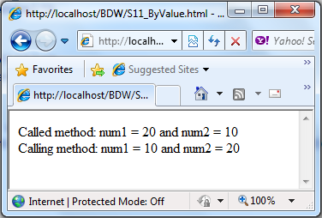
Calling by value- Demo
<html xmlns="http://www.w3.org/1999/xhtml">
<head>
<title>Calling function by value</title>
<script language="javascript" type="text/javascript">
function swap(num1, num2)
{
var temp = num1; num1 = num2; num2 = temp;
document.write("Called method: num1="+num1+ " and num2=" + num2);
}
function calculate()
{
var num1=10, num2=20;
swap(num1, num2); //Invoking the swap mathod
document.write("<br>Calling method: num1 = " + num1 + " and num= " + num2);
}
</script>
</head>
<body onLoad="calculate()">
</body>
</html>

Slide 8
Calling by reference - Demo
<html xmlns="http://www.w3.org/1999/xhtml">
<head>
<title>Calling function by reference</title>
<script language="javascript" type="text/javascript">
function modify(names)
{
names[0] = "Thanh Hung";
}
function initialize()
{
var names = new Array("James","Helene","John");
document.write("Before invoking method:<br>");
for(var i=0; i<names.length; i++)
document.write(names[i] + " - ");
modify(names); //Invoking method
document.write("<Br>After invoking method:<br>");
for(var i=0; i<names.length; i++)
document.write(names[i] + " - ");
}
</script>
</head>
<body onLoad="initialize()“></body></html>

Slide 9
return statement
JavaScript allows you to send the result back to the calling function by using return statement.
Syntax:
return <expression>

Slide 10
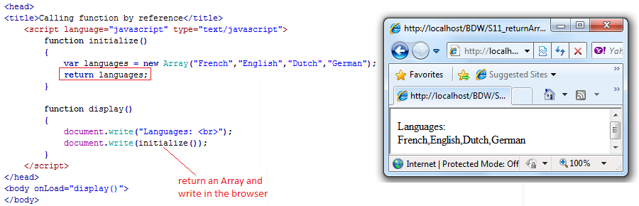
Returning an array
You can use the return statement to return a collection of values stored in arrays.
Syntax:
return <ArrayObject>

Slide 11
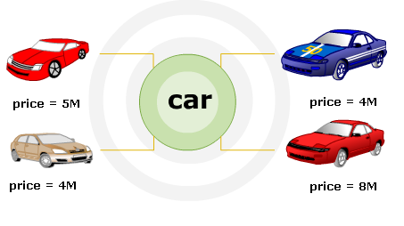
Object definition
In JavaScript, object is a collection of properties and methods. Properties specify the characteristics or attributes of an object, while methods identify the behavior of an object.
For example, car is an object in the real world.
  Car properties: brand, model, color, number, …
  Car methods: run, reverse, brake, …
In JavaScript, objects have their own properties and methods. JavaScript provides built-in objects and allows creating user-defined objects.
Pre-defined objects are those objects that are already defined and you just need to use their properties and methods to perform a specific task. (e.g. Array object).

Slide 12
Creating user-defined objects
Can create custom objects to store related data in a script. Example: to store the doctor details such as name, age, hospital name …, can to create doctor object.
There are two methods to create a custom object:
  By using Object object: This is known as the direct method.
  var <objectName> = new Object();
  By defining a template and initializing it with the new keyword. There are two steps to create an object by using this method.
    First: Declare the object type by using the constructor.
    Second: Specify the object of declared object type by using the new keyword.
  function <objectType>(paraList)
  {
  //Body specifying properties and methods
  }

Slide 13
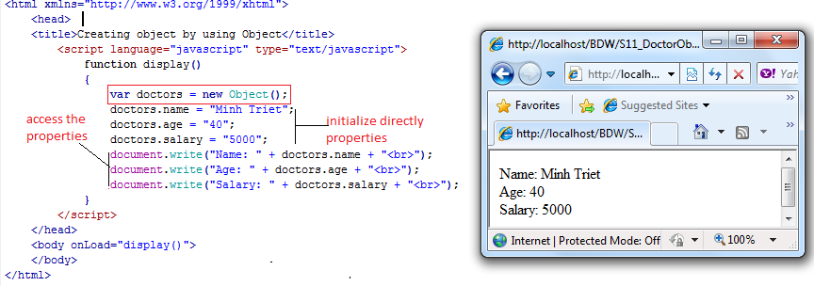
By using Object object - Demo
Notes:
Trong JS sau khi tạo xong 1 đối tượng ta sẽ them các thuộc tính và phương thức cho nó

Slide 14
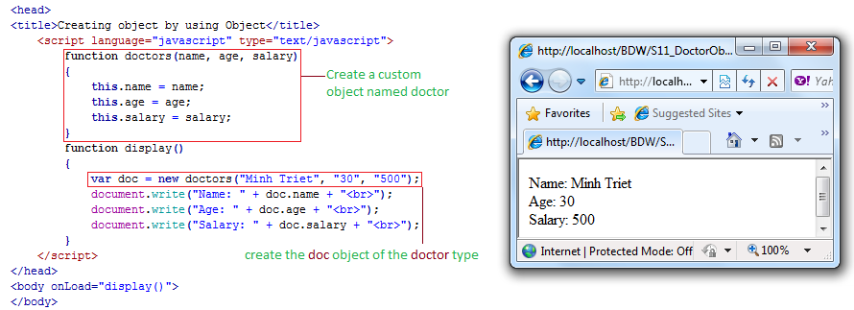
By defining template - Demo

Slide 15
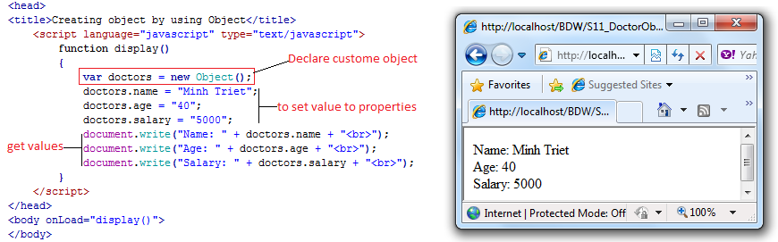
Creating properties
You can define properties of a custom object by specifying the object name followed by a period and property name.
To get value to property of custom object:
<objectName>.<property>
To set value to property of custom object:
<objectName>.<property> = <value>

Slide 16
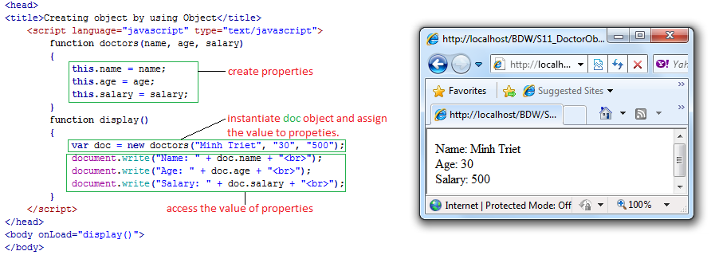
Creating properties in template
You can specify the properties in the template, if the template method is implemented to create a custom object.
In the constructor to create the custom object, you want to declare properties with the same names as that of parameters to specify meaningful names of properties.
Finally, you can set and get the value o properties easily.

Slide 17
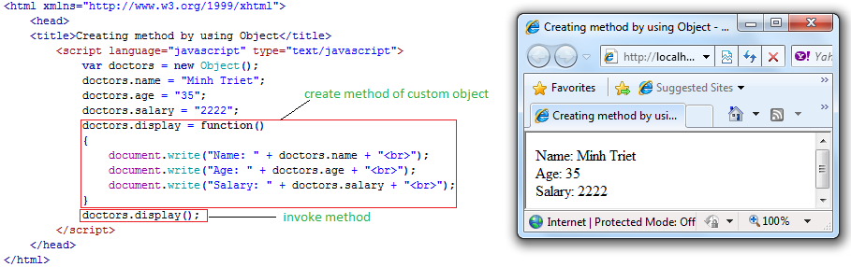
Creating methods
There are two ways to define methods o custom object.
First way: for the custom object created by Object object.
<objectName>.<MethodName> = function([paraList])
{
//Body of function
}

Slide 18
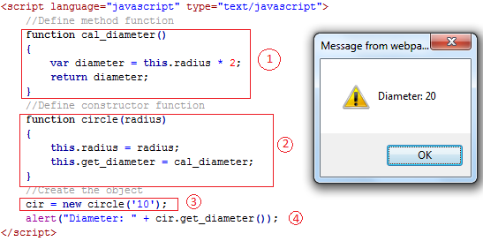
Creating methods in a template
Second way: creating methods in a template. You can create the custom method with the following steps:
  Define a method function that implements a functionality.
  Define a constructor function where the custom method is assigned the name of the method function.
  Create an object.
  Invoke the custom method, which in turn, will invoke the method function.

Slide 19
with statement
You need to use the object name every time when you want to access its properties and methods. This affects the readability of the code. To overcome this drawback, you can use the with statement.
The with statement allows you to remove the object reference for each JavaScript statement. You can reference directly properties and methods of the object after using with statement with object.
Syntax:
  With(<objectName>)
  {
  //statements
  }

Slide 20
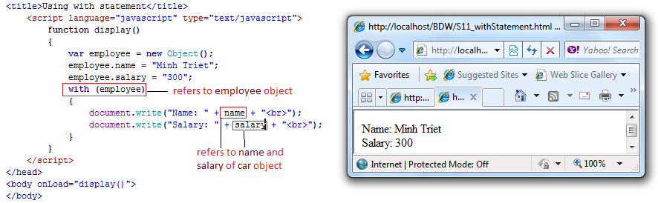
with statement - Demo

Slide 21
String object
Strings in JavaScript are set of characters that are surrounded by single or double quotes.
The built-in String object represents such a set of characters and allows you to perform different text operations on them.
You can perform these text operations by creating an instance (custom object) the String object.
Syntax:
var <objectName> = new String(“strings”);
Example:
var name = new String(“John Smith”);

Slide 22
Properties and methods of String object
Properties:
  length: retrieves the number of characters in a string.
Methods:
  chartAt(): retrieves a character from a particular position within a string.
  concat(): concatenates two strings.
  indexOf(): retrieves the position at which the specified string value first occurred in the string.
  lastIndexOf(): retrieves the position at which the specified string value last occurred in the string.
  match(): matches a regular expression with the string and replaces it with a new string.
  search(): searches for a match where the string is in the same format as specified by a regular expression.

Slide 23
Properties and methods of String object
Methods:
  split(): divides the string into substrings and defines an array of these substrings.
  substring(): retrieves a part of a string between the specified positions of a string.
  toLowerCase(): specifies the lowercase display of the string.
  toUpperCase(): specifies the uppercase display of the string.
  charCodeAt(): retrieves the Unicode of character located at a particular position.
  fromCharCode(): retrieves the string representation of the specified set of Unicode values.
  substr(): retrieves the particular number of a characters in a string from the specified index until the specified length.

Slide 24
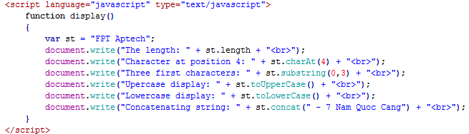
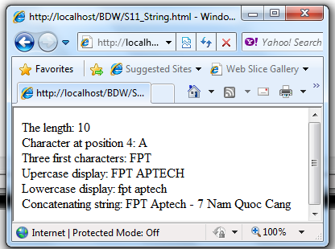
String object - Demo

Slide 25
Math object
The Math object allows you to perform mathematical operations on numeric values. It is a pre-defined object that provides static properties and methods to perform mathematical operations.
Properties:
  E: retrieves the Euler’s constant that is approximately 2.7183.
  PI: retrieves the value of pi that is approximately 3.142.
Syntax to use Math properties:
  var <variableName> = Math.<Property>
Example:
  var Pi = Math.PI;

Slide 26
Methods of Math object
Methods:
  abs(): retrieves the absolute value of a numeric value.
  ceil(): retrieves the integer greater than or equal to the given numeric value.
  floor(): retrieves the integer less than or equal to the given numeric value.
  exp(): returns E exponent of parameter value.
  max(): retrieves the greatest value from the list of values passed as arguments.
  min(): retrieves the most lesser value from the list of values passed as arguments.
  pow(): calculates and retrieves the value of a raised to the power of b.

Slide 27
Methods of Math object
Methods:
  random(): retrieves a random value between 0 to 1.
  round(): is used to round the number.
  sqrt(): retrieves the square root of a numeric value.

Slide 28
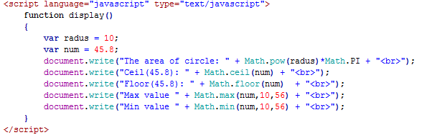
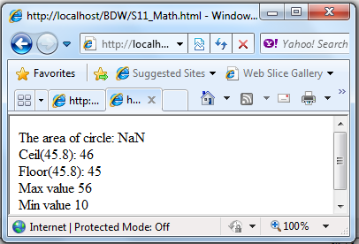
Math object - Demo

Slide 29
Date object
The Date object allows you to define and manipulate the date and time values programmatically.
The Date object calculates dates in milliseconds from 01 January, 1970.
You can specify date and time by creating an instance of the Date object. This is done by instantiating the Date object with the new keyword.
Syntax:
  var <objectName> = new Date();
Example:
  var today = new Date();

Slide 30
Methods of Date object
Methods:
  getDate(): retrieves the day of month (1-31).
  getDay(): retrieves the day of week (0-6).
  getMonth(): retrieves the month of year (0-11).
  getFullYear(): retrieves the year.
  getHours():retrieves the hour value between 0 and 23.
  getMinutes(): retrieves the minute value (0-59).
  getSeconds(): retrieves the second value (0-59).
  getTime(): retrieves a numeric value, which indicates the time passed in milliseconds since midnight 01/01/1070.
  setTime(): specifies the time based on the given milliseconds, which have been elapsed since 01/01/1970.

Slide 31
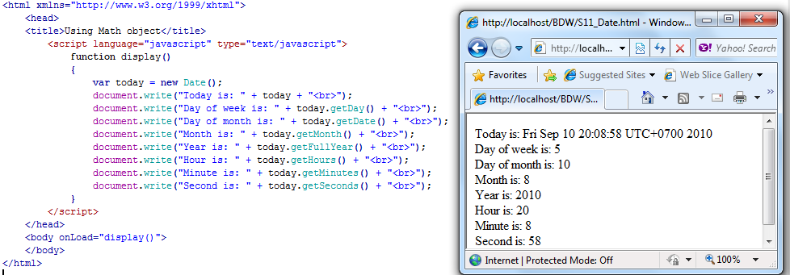
Date object - Demo

Slide 32
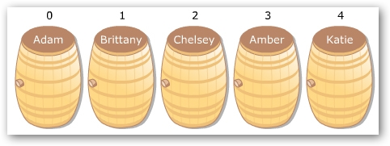
Single-dimensional arrays
An array is a collection of values stored in adjacent memory locations. These array values are referenced using a common array name.
The values of array are the same data type. These values can be accessed by using the subscript or index numbers. The index determines the position of element in the array list.
In a single-dimensional array, the elements are stored in a single row in the located memory.
In JavaScript, the first element has the index number zero.
Index
Value

Slide 33
Declaring arrays
There are three ways to declaring an array:
Using the Array object: declare an array by using the new operator, and then initialize the individual array elements:
var arr = new Array(3);
arr[0] = “Single”;
arr[1] = “Married”;
arr[2] = “Divorced”;
Initialize the array variable at the time of declaration:
var arr = new Array(‘Single’,’Married’,’Divorced’);
Creates an array without using Array object:
var arr = {‘Single’,’Married’,’Divorced’};

Slide 34
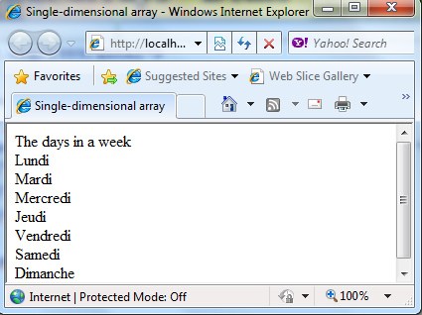
Single-dimensional arrays - Demo
<html xmlns="http://www.w3.org/1999/xhtml">
<head>
<title>Single-dimensional array</title>
<script language="javascript" type="text/javascript">
var arr = new Array("Lundi", "Mardi", "Mercredi", "Jeudi", "Vendredi", "Samedi","Dimanche");
document.write("The days in a week <br>");
for(i=0; i<arr.length; i++)
{
document.write(arr[i] + '<BR>');
}
</script>
</head>
</html>

Slide 35
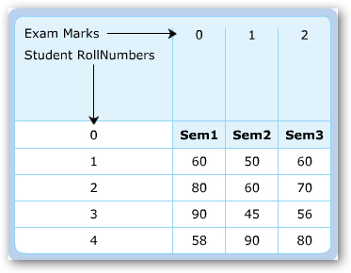
Multi-dimensional arrays
A multi-dimensional array stores a combination of values of a single type in two or more dimensions.
A two-dimensional array represents as rows and columns similar to a table.
JavaScript does not directly support two-dimensional array. You can create two-dimensional array by creating an array of arrays. You first declare an array and then create another array to each element of the main array.
var emp= new Array(3);
emp[0] = new Array(‘John’,’300’);
emp[1] = new Array(‘David’,’400’);
emp[2] = new Array(‘Richard’,’500’);

Slide 36
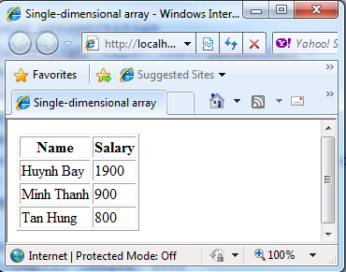
Multi-dimensional arrays - Demo
<html xmlns="http://www.w3.org/1999/xhtml">
<head>
<title>Single-dimensional array</title>
<script language="javascript" type="text/javascript">
var emp = new Array(3);
emp[0] = new Array('Huynh Bay','1900');
emp[1] = new Array('Minh Thanh','900');
emp[2] = new Array('Tan Hung','800');
document.write('<table border=1> <tr> <th>Name</th> <th>Salary</th> </tr>');
for(var i=0; i<emp.length; i++)
{
document.write('<tr>');
for(var j=0; j<emp[i].length; j++)
document.write('<td>' + emp[i][j] + '</td>');
document.write('</tr>');
}
</script>
</head>
</html>

Slide 37
Array methods
An array is a set of values grouped together an identified by a single name. In JavaScript, an Array allows you to create arrays. It provides the length property that is used to determine the number of elements in an array.
The various methods allow you to access and manipulate the array elements:
- concat: combines one or more array variables.
- join: joins all the array elements into a string.
- pop: retrieves the last element of an array.
- push: appends one or more elements to the end of an array.
- sort: sorts the array elements in alphabetical order.
- reverse: retrieves the elements from the last to the first index position.
- toString: converts the array elements into string.

Slide 38
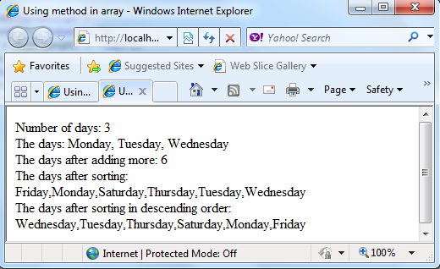
Array methods - Demo
<html xmlns="http://www.w3.org/1999/xhtml">
<head>
<title>Using method in array</title>
<script language="javascript" type="text/javascript">
var days = new Array('Monday','Tuesday','Wednesday');
document.write('Number of days: ' + days.length + '<br>');
document.write('The days: ' + days.join(', ') + '<br>');
document.write('The days after adding more: ' + days.push('Thursday','Friday','Saturday') + '<br>');
document.write('The days after sorting:' + days.sort() + '<br>');
document.write('The days after sorting in desceding order:' + days.reverse() + '<br>');
</script>
</head>
</html>

Slide 39
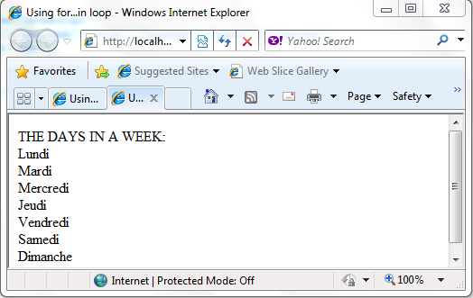
for … in Loop
The for…in loop is an extension of for loop. It enables you to perform specific actions on the array objects. The loop reads every element in the specified array and executes a block of code once for each element in the array.
Example:
<html xmlns="http://www.w3.org/1999/xhtml">
<head>
<title>Using method in array</title>
<script language="javascript" type="text/javascript">
var arr = new Array("Lundi", "Mardi", "Mercredi", "Jeudi", "Vendredi", "Samedi","Dimanche");
document.write('THE DAYS IN A WEEK: <BR>');
for(var i in arr)
{
document.write(arr[i] + '<br>');
}
</script>
</head>
</html>

Slide 40
Summary
JavaScript function is a block of code that can be reused later in the script.
JavaScript Object is a set of properties and methods, which allow store and manipulate information about specific entity.
Can create custom functions, custom objects with custom properties and methods.

Slide 41
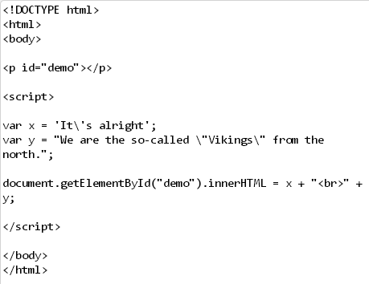
exercise

Slide 42
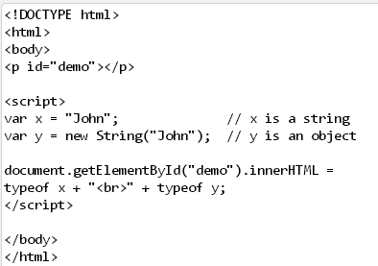
exercise

Slide 43
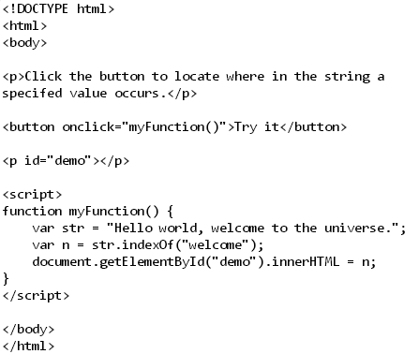
exercise

Slide 44
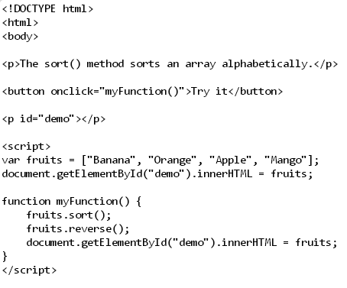
exercise

Slide 45
exercise
Notes:
The slice() method selects elements starting at the start argument, and ends at, but does not include, the end argument.

Slide 46
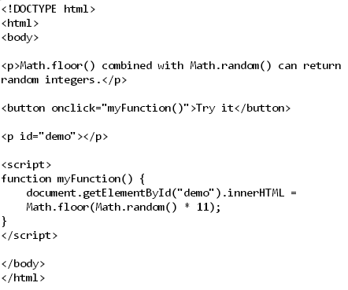
exercise

Slide 47
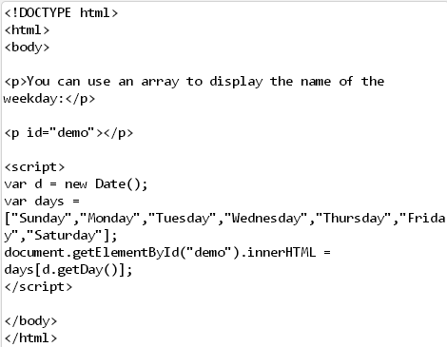
exercise

Slide 48
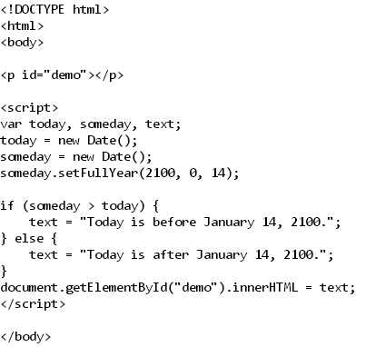
exercise

